Slide 1

C++ Workshop 1 Basic Code Structures
Panagiotis Petridis
Brought to you by HackSoc

Slide 2
Variable Declarations
var_type var_name = value;
Available types:
int
unsigned
short
float
char
double
long [long]
string*
int a = 0;
int b = 3;
a += 5;
b = b - a * 3;

Slide 3
Arrays
Indexing
type var_name[] = {value, value,
…, 22, 1};
type var_name[3] = {value, value, value};
type var_name[constant value];
C++ does NOT do bound checking!!!
type var_name[3] = {value, value, value};
var_name[4] = ??
Segmentation Fault

Slide 4
If-else statements
if (condition) {
// code…
} else if (another_condition) {
// code…
} else {
// code…
}
if (true) {
// code…
} else if (true || (1 && false) ){
// code…
} else {
// code…
}

Slide 5
Loops
for (statement; condition; statement) {
// code…
}
while (condition) {
// code…
}
do {
// code…
} while (condition);
for(int i = 0; i < 10; i ++) {
}
while (true) {
}
do {
// code…
} while (false);

Slide 6
Switch statements
switch(variable) {
case value:
// code…
break;
case value:
// code…
break;
default:
// code…
break;
}
switch(error_code) {
case 200:
// OK
break;
case 404:
// NOT FOUND
break;
default:
// PANIC
break;
}

Slide 7
Functions
type func_name(type p1, type p2, …) {
return value;
}
void do_stuff (int a, string s) {
return a + s.size();
}
int main() {
// code…
return 0;
}
void exit_early() {
// code will run
return;
// code won’t run
}

Slide 8
Structs
struct name {
type var;
name() {
// initialize
}
type fun() {
return value;
}
};
struct name {
type first_name;
type last_name;
type full_name() {
return first_name + last_name;
}
};

Slide 9
Classes (fancy structs)
class Animal {
public:
Animal(type var, …) { … } type fun() { ... }
type var; // don't do this
private:
type fun_fun() { ... };
type var;
type var;
};
class Animal { … };
int main() {
Animal doggo("Ector", "woof");
doggo.make_sound();
return 0;
}

Slide 10
#include libraries
You can include libraries that exist in your PATH with:
#include <library_name>
To include code from other files you can use:
#include "library_name.cpp"
#include "library_name.h"
#include <iostream>
#include <vector>
#include "my_algorithms.cpp"
#include "my_cool_class.h"

Slide 11
Namespaces
using namespace my_namespace;
namespace my_namespace {
// separated code…
}
using namespace std;
namespace my_namespace {
void my_function() { … }
}
my_namespace::my_function();

Slide 12
Output to console I/O stream
#include <iostream>
using namespace std;
int main() {
cout << "Hello World!" << endl;
return 0;
}
#include <iostream>
int main() {
int a = 7;
std::cout << "Lucky number: " << a
<< std::endl;
return 0;
}

Slide 13
User input
#include <iostream>
using namespace std;
int main() {
string name;
cin >> name;
cout << "Hello " << name << endl;
return 0;
}

Slide 14
Setup workspace
http://coliru.stacked-crooked.com/

Slide 15
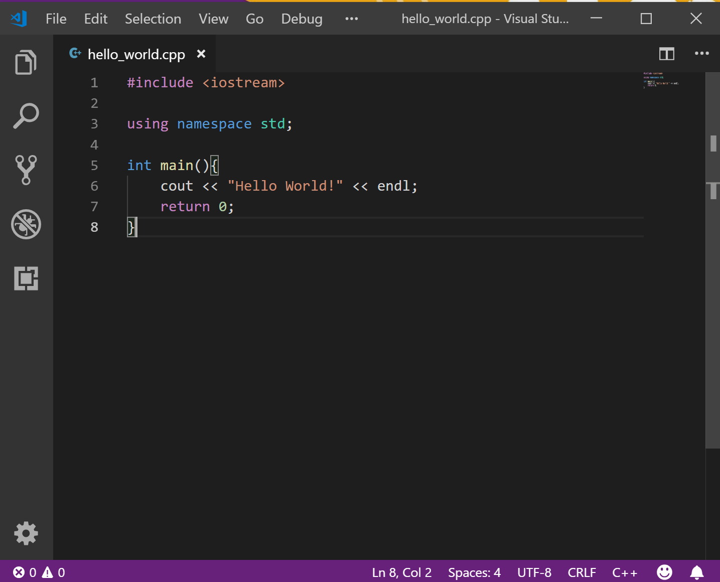
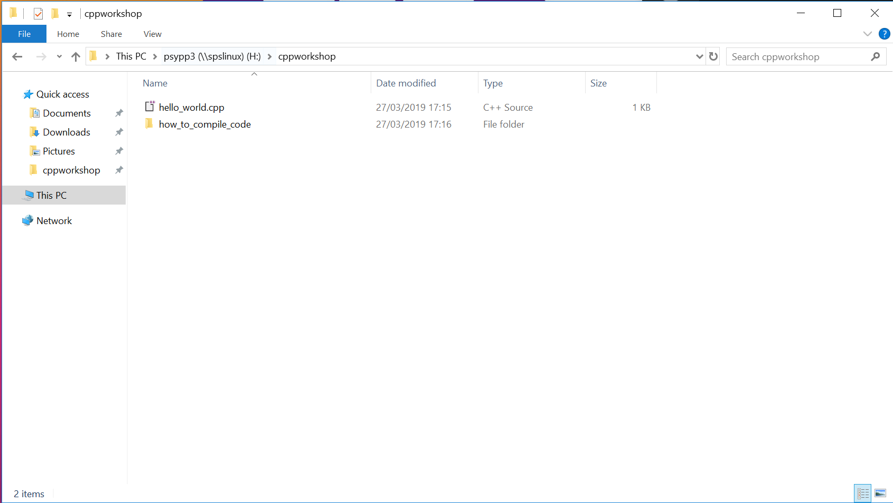
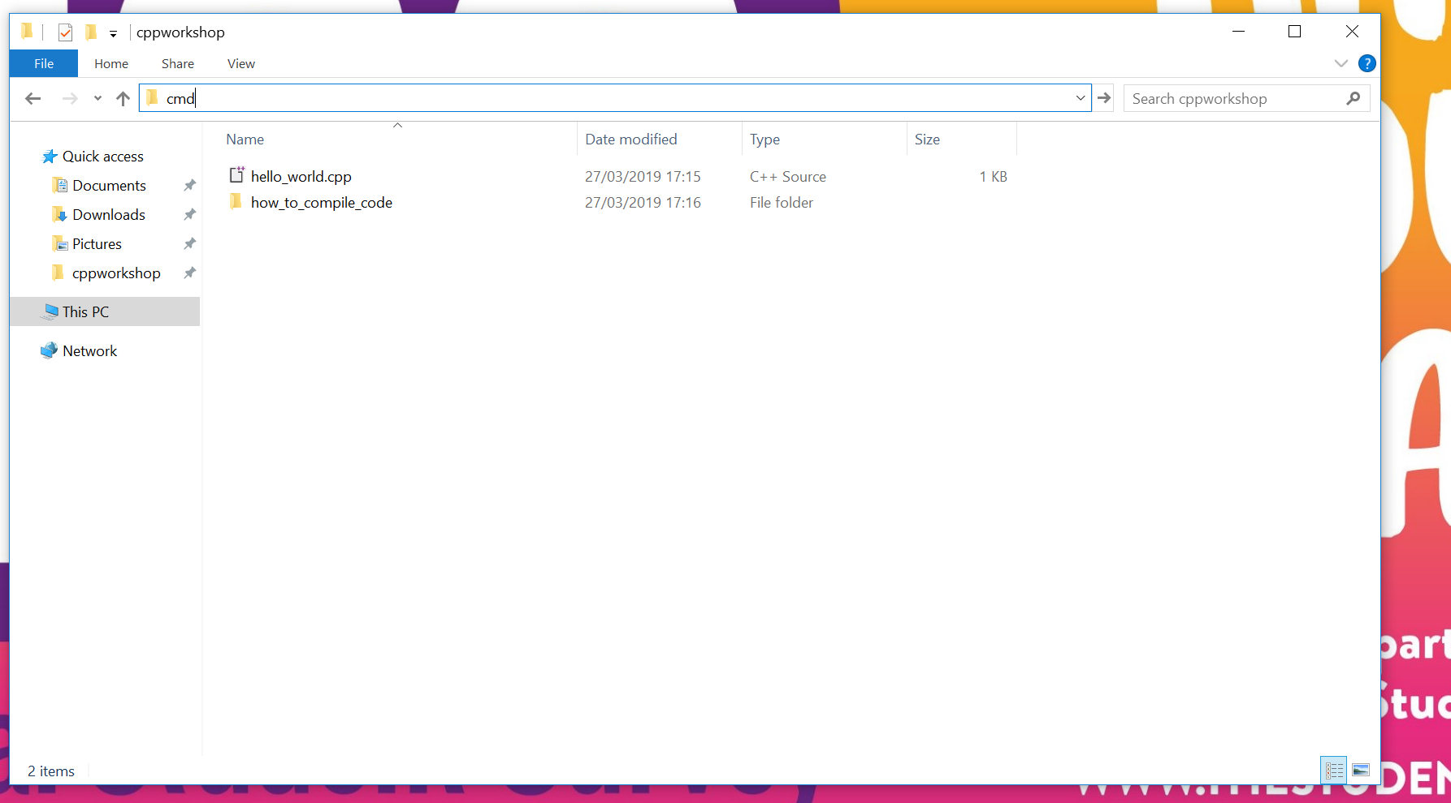

Slide 16
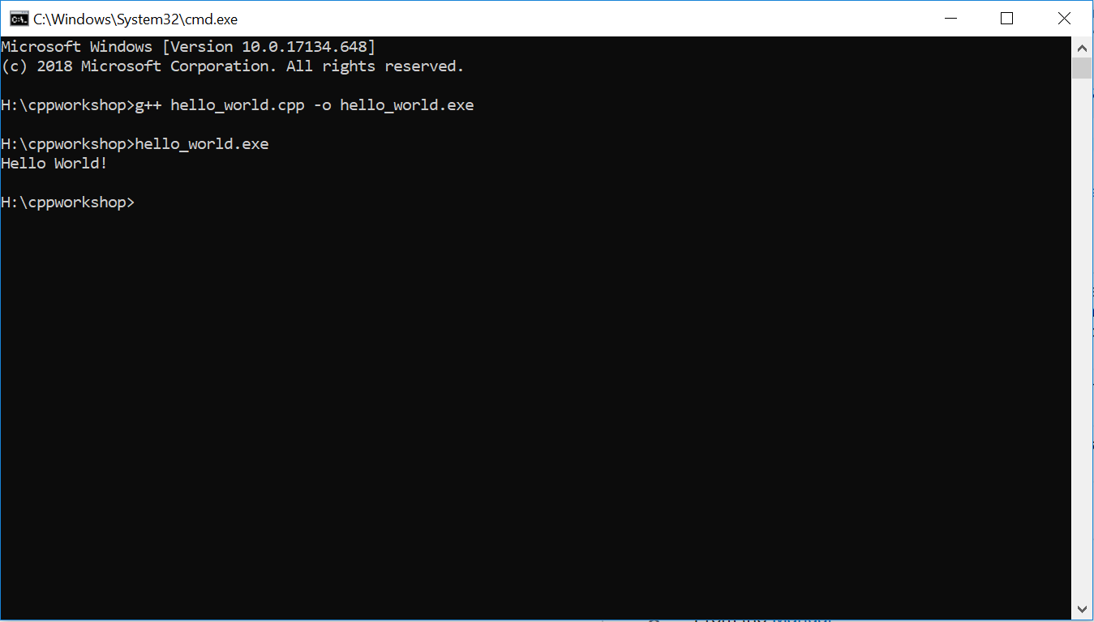
compile with g++ (c++ on mac)

Slide 17
Practice!
https://www.hackerrank.com/
Resources:
https://github.com/PanagiotisPtr/cpp_workshop

